Slide 1
Graphs
Israt Jahan Rinky
Lecturer
Dept. of CSE, Varendra University.

Slide 2
Graphs
Graphs is special data structure, which we can represent through two sets-
Set of Vertices / Nodes - V
Set of Edges - E
Let,
V = {1, 2, 3, 4}
E = {(1,2), (2,3), (1,4)}
{1,2}
1
2
SET OF VERTICES
{1,3}
{2,4}
{2,3}
V = { 1, 2, 3, 4 }
{3,4}
3
4
SET OF EDGES
{1,4}
E = { (1, 2), (1, 3), (2, 3), (2, 4), (3, 4), (1, 4) }

Slide 3
Definition
A graph is a bunch of vertices (or nodes) represented by circles which are connected by edges, represented by line segments.
A graph G = (V , E) consists of V, a nonempty set of vertices (or nodes) and E, a set of edges (possibly empty). Each edge has either one or two vertices associated with it, called its end points. An edge is said to connect its endpoints.

Slide 4
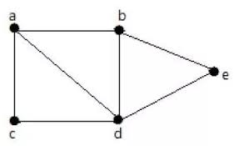
Graphs Example
Connected graph:
A connected graph is graph that is connected in the sense of a topological space, i.e., there is a path from any point to any other point in the graph. A graph that is not connected is said to be disconnected.

Slide 5
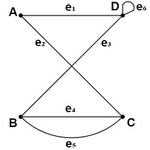
Multigraph
A multigraph is a graph that can have more than one edge between a pair of vertices.
A graph in which multiple edges between same vertices are either permitted, these edges that have the same endpoints. Thus, two vertices may be connected by more than one edge.

Slide 6
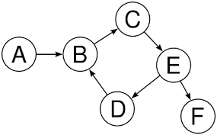
Directed graph
A directed graph, also called a digraph, is a graph in which the edges have a direction. This is usually indicated with an arrow on the edge; more formally, if v and w are vertices, an edge is an unordered pair {v,w}, while a directed edge, called an arc, is an ordered pair (v,w) or (w,v).

Slide 7
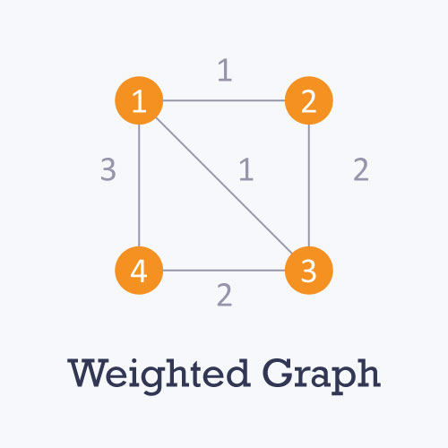
Weighted Graph
A weighted graph is a graph in which each branch is given a numerical weight. A weighted graph is therefore a special type of labeled graph in which the labels are numbers (which are usually taken to be positive).

Slide 8
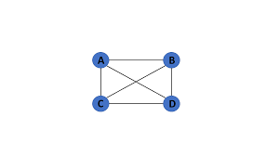
Fully connected/Complete graph
A graph in which each vertex is connected to every other vertex is called a complete graph.

